Slide 1


Machine Learning for Advanced Aircraft Load Prediction & Optimization
Prepared by: Sara Khosravi
ML Engineer - Aircraft Load Prediction & Optimization
Summer 2018

Slide 2

Content
Problem Definition: Enhance aircraft load prediction reliability.
Data Collection: Collect historical flight and sensor data.
Data Cleaning: Analyze and clean data for patterns and anomalies.
Data Preparation: Engineer features and split data into training/testing sets.
Model Selection: Choose suitable ML algorithms.
Model Training: Train models and tune hyperparameters.
Model Evaluation: Assess performance with metrics.
Model Deployment and Monitoring: Deploy the best model in production and monitoring and continuously monitor and retrain the model.
Conclusion

Slide 3
Problem Definition - Executive Summary
Challenges with Traditional Methods: Traditional aircraft load calculation methods struggle with complex non-linear relationships.
ML Integration: Integration of machine learning (ML) enhances load prediction accuracy and optimization.
Data and Feature Engineering: Detailed data collection, feature engineering, model training, and selection processes.
Model Performance: The Gradient Boosting model significantly improved prediction accuracy.
Comprehensive Calculations: Detailed load calculations, geometric specifications, and technical considerations for the Faez aircraft.
Methodology Integration: Combined traditional aerospace engineering methodologies with modern ML approaches.
Broad Condition Coverage: Covered various flight conditions, including temperature levels, weather, and operational scenarios.

Slide 4
Problem Definition - Introduction
Advanced prediction models and simulations were used to meet JAR-23 safety and performance standards.
Comprehensive Analysis Across All Aircraft Parts:
Employed thorough evaluation techniques to ensure optimal load distribution and structural integrity.
Successful Creation and Flight:
Cost-Effective Testing Strategy:
Leveraged prediction models and simulations to significantly reduce reliance on expensive wind tunnel tests.
Confirmed design viability and safety through simulations before physical prototyping, leading to substantial cost savings
The Light aircraft completed its maiden flight, validating the efficacy of our predictive models and testing protocols.

Slide 5
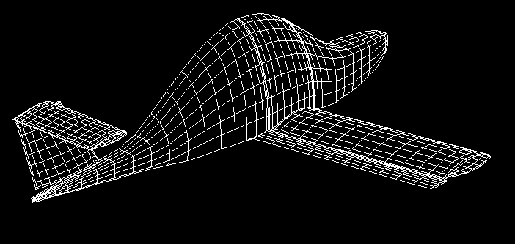
Data Collection and Cleaning
Initial load estimation based on JAR-23 aviation standards.
Final load calculations using CMARC software, ensuring compliance with industry standards.
Historical flight data, sensor measurements, and environmental data.
Feature engineering to improve model training.

Slide 6
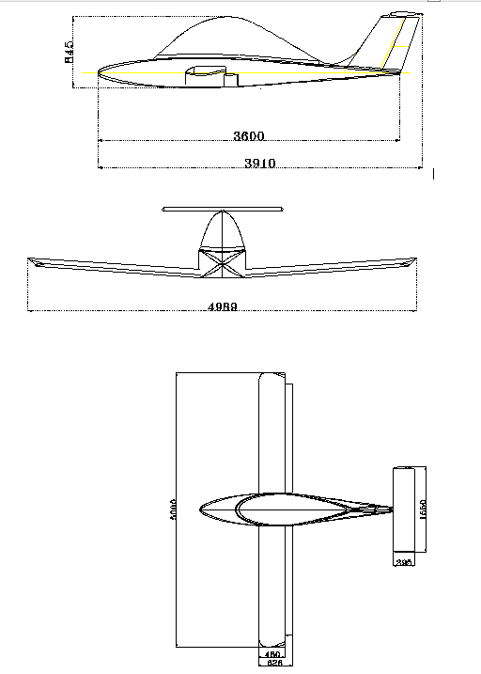
General Information:
Maximum Takeoff Weight: 170 kg
Maximum Load Factor: 6
Tail Assembly Specifications:
Horizontal Tail Area: 0.61 m²
Vertical Tail Area: 0.38 m²
Horizontal Tail Span: 1.55 m
Vertical Tail Span: 0.67 m
Horizontal Tail Root Chord: 0.40 m
Vertical Tail Root Chord: 0.65 m
Vertical Tail Tip Chord: 0.46 m
Data Preparation - Initial Load Estimation of Light Aircraft
General Information:
Maximum Takeoff Weight: 170 kg
Maximum Load Factor: 6
Tail Assembly Specifications:
Horizontal Tail Area: 0.61 m²
Vertical Tail Area: 0.38 m²
Horizontal Tail Span: 1.55 m
Vertical Tail Span: 0.67 m
Horizontal Tail Root Chord: 0.40 m
Vertical Tail Root Chord: 0.65 m
Vertical Tail Tip Chord: 0.46 m
Wing Specifications:
Wing Area: 3.1 m²
Wing Span: 5 m
Wing Chord: 0.625 m
Aspect Ratio: 7.8

Slide 7
Data Preparation - Basis for Loading the Light Aircraft
Pressure distribution along the wing chord is determined by:
P₁ kg/m²
P₂ kg/m²
P₁=2.5 h(y) / C
P₂=h(y) / 0.8 C
So:
P₁=860 (kg/m²)
P₂=430 (kg/m²)
0.20C
0.85C
Load Distribution Along the Wing Chord
h= 215 kg/m
Distributed Load Along the Wing Span
F=n.W
h(y)=1.05(F/S)C
C_{r}=C_{t}=0.625 (m)
S=3.12 (m²)
5 m
Distributed Load Along the Wing Span

Slide 8
Data Preparation - Basis for Loading the Light Aircraft
Horizontal Tail Loading Content: Based on JAR-23 Appendix B, the distributed load along the horizontal tail span is:
h= 79.3 kg/m
nw/s=329 (kg/m²)
1550 mm
F_{H.T}=121 (kg)
Distributed Load Along the Horizontal Tail
Load Distribution Along the Horizontal Tail Chord Content: The load distribution spans from 100 mm with loads ranging from 794 kg/m² to 198 kg/m².
Upward deflection load: 89.4 kg
Downward deflection load: 62 kg
F_{H.T}=62 (kg)
F_{H.T}=89.4 (kg)
794 kg/m²
198 kg/m²
100 mm
300 mm
Load Distribution Along the Horizontal Tail Chord

Slide 9
Data Preparation - Basis for Loading the Light Aircraft
Vertical Tail Loading Content:
The total vertical tail load is 65.8 kg, with distributed loads calculated as follows:
Spanning 670 mm, the load per unit area ranges from 112.5 kg/m to 79.6 kg/m.
112.5 kg/m
79.6 kg/m
670 mm
Load Distribution Along the Vertical Tail Chord
F_{V.T}=65.8 (kg)

Slide 10
Data Preparation - Basis for Loading the Light Aircraft
Geometric Specifications of Light Aircraft:
Force(kg)
V.T | H.T | Wing
66 | 121 | 1070
Final Loading Calculations
V.T (semi.span) | H.T (semi.span) | Wing (semi.span)
66 | 61 | 535 | Forc(kg)
0.158 | 0.3875 | 1.25 | Location(m)
66 | 61 | 535 | Shear Force(kg)
10.4 | 23.6 | 669 | Ben.Moment(kg.m)

Slide 11
Data Preparation - Basis for Loading the Light Aircraft
Geometric Specifications of Light Aircraft:
Geometric Specifications of Light Aircraft:
Total Aircraft Weight: 170 kg
Positive Flight Load Factor: 6
Negative Flight Load Factor: -3
Maximum Mach Number: 0.26
Moment of Inertia (X-axis): 63.13 kg.m²
Moment of Inertia (Y-axis): 92.26 kg.m²
Distance from Horizontal Tail Force Application to CG: 2394 mm
Moment of Inertia (Z-axis): 137.8 kg.m²

Slide 12
Data Preparation - Basis for Loading the Light Aircraft
Aerodynamic Coefficients and Stability Derivatives:
‍‍Coefficient | Value
Cl0 | 0.325
Cla | 0.112
Clde | 0.00405
Clq | 0.111
Cm0 | 0.05
Cma | -0.0175
Cmde | -0.0145
Cmq | -0.242
Cm0 with out elevator | -0.0052
Cma with out elevator | -0.004
Cmq with out elevator | -0.01378

Slide 13
Data Preparation - Basis for Loading the Light Aircraft
V-n Diagram
The V-n diagram examines the aircraft's wing loading in all specified conditions. The critical wing conditions are examined after the aircraft balance calculations, and the results are analyzed. The V-n diagram below shows the load factor vs. speed relationship, indicating balance points throughout the flight envelope.

Slide 14
Data Preparation - Light Aircraft Flight Conditions
Table of Flight Conditions at Zero Altitude

Slide 15
Data Preparation - Light Aircraft Flight Conditions
Table of Flight Conditions with 12 Degree Flap
Table of Flight Conditions with 27 Degree Flap
Required Parameters for Balancing Light Aircraft
Aerodynamic Coefficients and Specifications of Light Aircraft

Slide 16
جدول بارهای تعادلی در ارتفاع صفر
Data Preparation - Loading Conditions for Light Aircraft
The loading of the Light aircraft is carried out using CMARC software. The initial load estimates are based on JAR-23 aviation standards.

Slide 17
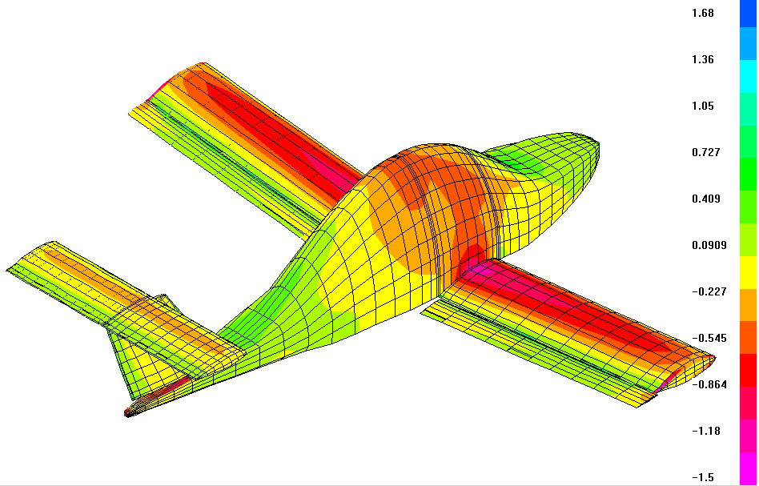
Pressure Distribution Schematic of Light Aircraft in Postmarc Environment
Data Preparation - Loading of Light Aircraft

Slide 18
Data Preparation - Loading of Light Aircraft
Balance and Critical Conditions of Light Aircraft

Slide 19
Data Preparation - Loading of Light Aircraft
Pressure distribution tables in different sections of the wing for one of the various flight conditions and in one flight section

Slide 20
Data Preparation - Loading of Light Aircraft
Pressure distribution tables in different sections of the wing for one of the various flight conditions and in one flight section

Slide 21
Data Preparation - Loading of Light Aircraft
Pressure distribution tables in different sections of the wing for one of the various flight conditions and in one flight section

Slide 22
Data Preparation - Loading of Light Aircraft
Distributed load table along the wing
Distributed load diagram along the wing

Slide 23
Data Preparation - Loading of Light Aircraft
Shear force table along the wing
Shear force distribution diagram along the wing

Slide 24
Data Preparation - Loading of Light Aircraft
Bending moment table along the wing
Bending moment distribution diagram along the wing

Slide 25
Data Preparation - Loading of Light Aircraft
Torsional moment table along the wing
Torsional moment distribution diagram along the wing

Slide 26
Model Selection and Training
Algorithm Selection: The rationale behind selecting specific ML algorithms, such as Gradient Boosting, is based on their ability to capture non-linear relationships. Gradient Boosting, for instance, is advantageous due to its high accuracy and robustness in handling complex interactions between features.
Hyperparameter Tuning: Hyperparameter tuning techniques, such as Grid Search, optimize model performance. For example, Grid Search was used to fine-tune the Gradient Boosting model, enhancing prediction accuracy.

Slide 27
Machine Learning Predictions for Various Flight States
Feature | Description | Value Range
Wing Loading | Load per unit area on the wing | 300 - 900 kg/m²
Tail Loading | Load per unit area on the tail | 100 - 500 kg/m²
Temperature | Ambient temperature | -20°C to 50°C
Weather Condition | Type of weather (clear, rainy) | Clear, Rainy, Windy
Flight Condition | Specific flight scenarios | Takeoff, Cruise, Landing
Altitude | Altitude of the flight | 0 - 40,000 ft
Wind Speed | Wind speed during flight | 0 - 100 km/h
Flight State | Temperature (°C) | Weather Condition | Load Factor (n) | Wing Load (kg/m²) | Tail Load (kg/m²)
Takeoff | 25 | Clear | 4 | 350 | 120
Cruise Low | 15 | Windy | 1.5 | 450 | 200
Cruise High | -10 | Clear | 1.2 | 430 | 180
Landing | 30 | Rainy | 3 | 500 | 150
Emergency | 20 | Windy | 2.8 | 600 | 250
... | ... | ... | ... | ... | ...
State 2000 | 40 | Windy | 3.5 | 700 | 300

Slide 28
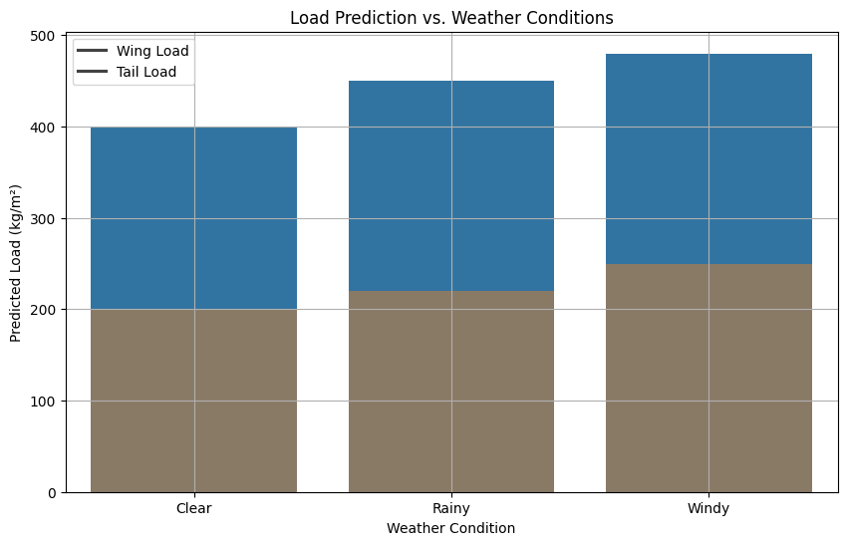
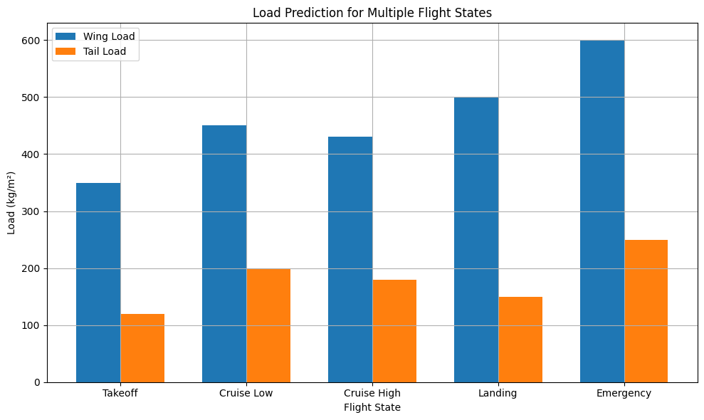
Model Evaluation - Graphical Representation
Graph 1: Load Prediction vs. Weather Conditions
This bar chart compares the predicted loads on the wing and tail under different weather conditions. It highlights how various environmental factors can impact the load distribution on the aircraft.
Graph 2: Load Prediction for Multiple Flight States
This bar chart shows the predicted loads on the wing and tail for various flight states. It helps visualize the differences in load distribution during different phases of flight, including takeoff, cruise, landing, and emergency maneuvers.

Slide 29
Model Training and Evaluation
The dataset was split into training and testing sets to evaluate model performance effectively.
Features were standardized to ensure all models received data on a similar scale.
Each model was trained using the scaled training data.
Models evaluated include Linear Regression, Ridge Regression, Lasso Regression, Random Forest, Gradient Boosting, Support Vector Regressor, XGBoost, and LightGBM.

Slide 30
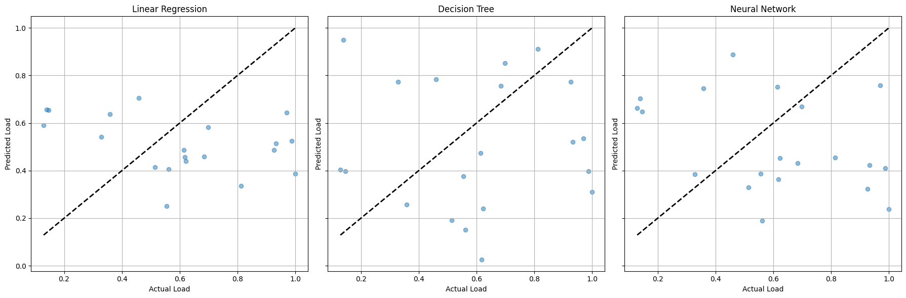
Model Evaluation
Performance metrics (MSE and R-squared) for each model.
Model | Mean Squared Error | R-squared
Linear Regression | 0.0028 | 0.918
Ridge Regression | 0.0029 | 0.917
Lasso Regression | 0.0032 | 0.913
Random Forest | 0.0019 | 0.941
Gradient Boosting | 0.0018 | 0.945
SVR | 0.0021 | 0.937
XGBoost | 0.0017 | 0.948
LightGBM | 0.0018 | 0.946
Scatter Plot: Actual vs Predicted

Slide 31

Hyperparameter Tuning and Final Model Performance
Grid Search for Gradient Boosting to find the optimal hyperparameters.
Best model parameters and performance metrics.
Summary of the best performing model (Gradient Boosting with tuned hyperparameters).
Final performance metrics (MSE and R-squared).

Slide 32
Conclusion and Inference on Load Analysis of Light Aircraft
Generally, every aircraft uses the horizontal tail and elevator control surface to maintain balance and perform maneuvers in the vertical plane. The loading of the horizontal tail is examined in all flight conditions.
The loads applied to the horizontal tail are determined in two forms: balancing loads and maneuvering loads. Balancing loads are specified in the aircraft balance section.
Loading calculations are performed at different altitudes and for takeoff and landing conditions. For each flight envelope, different flight conditions are considered based on maneuvering characteristics, and after performing the necessary calculations, the critical loads are used in structural analysis.

Slide 33
Conclusion and Inference on Load Analysis of Light Aircraft
Successful Application of ML Techniques:
Demonstrated the successful application of machine learning techniques for predicting and optimizing aircraft load distribution.
Significant improvements in prediction accuracy, particularly with the Gradient Boosting model after hyperparameter tuning.
Key Achievements:
Conducted comprehensive analysis across all aircraft parts, including the wing, tail assembly, and fuselage.
Utilized advanced prediction models and simulations to reduce reliance on expensive wind tunnel tests.
Successfully created and achieved flight for the Light aircraft, validating the efficacy of our predictive models and testing protocols.

Slide 34
Thank you for your attention!
Sara Khosravi

